Slide 1
Network Authenticated Assembly
Infosys Ltd., British Telecom, Telstra
Contacts:
abhisek.das04@infosys.com
bishnu_panda@infosys.com
pawan.7.kumar@bt.com
shyamtanu.banerjee@team.telstra.com;

Slide 2
Contents
Background
Sample implementation
High level description
NAA API Family
Sequence Diagram
User story
Deliverables Status
Double click on open pointers

Slide 3
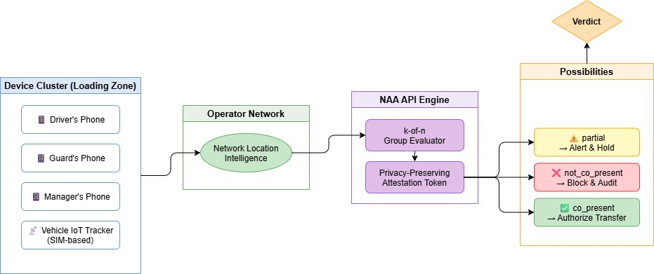
Background- Network‑Authenticated Assembly
API benefit
Verify a group of SIM/eSIM devices are physically co-located — in a single API call; Zone is supplied by the caller as a standard Area object; no device coordinates are exposed in the response (the area definition may still include coordinates)
k-of-n group verdict — co_present / partial / not_co_present — configurable minimum threshold per cluster
Signed attestation token — act on trusted presence without revealing any individual device position
Two modes: on-demand POST /verify and continuous POST /assembly-subscriptions
Zero new operator capability required — composes existing network location intelligence server-side
New business scenarios driven：
NAA enables trust automation for physical multi-party workflows in Banking (cash-in-transit), Logistics, Field Services, Healthcare, and Controlled-Access Infrastructure — anywhere people, devices, and assets must be confirmed together before a sensitive action is authorized

Slide 4
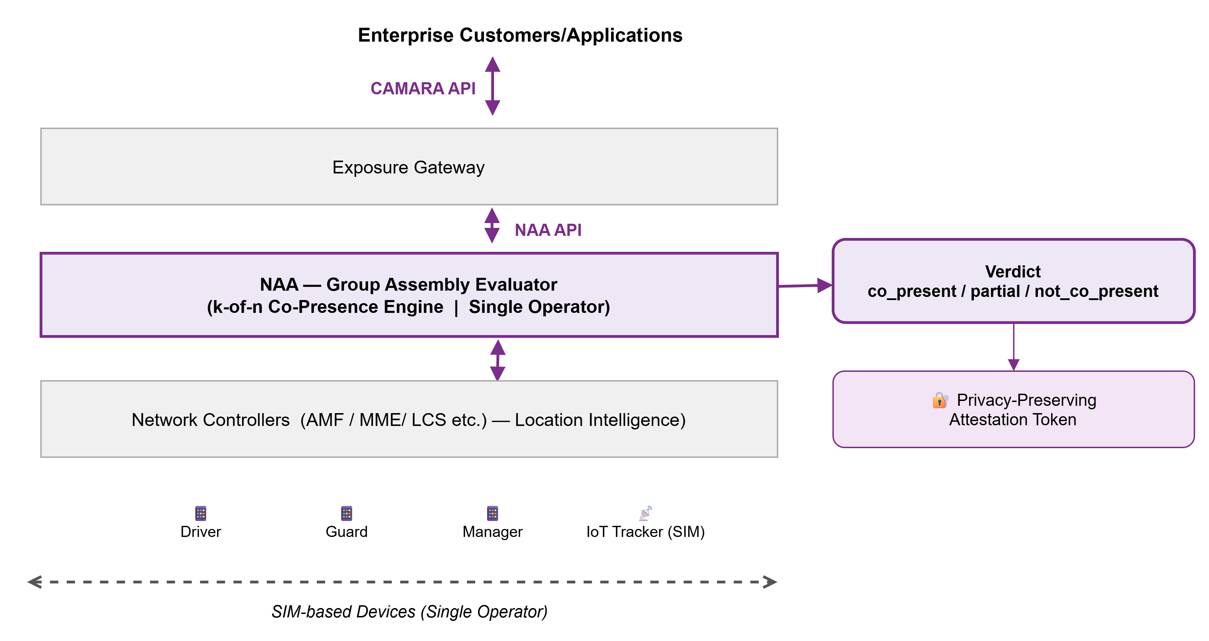
Sample implementation: Network Authenticated Assembly

Slide 5
NAA API: High level description
Truth Table
Group Verdict (k-of-n semantics)
NAA verifies that a defined group of SIM-based devices are physically co-located within a zone and time window — returning a single group verdict (co_present / partial / not_co_present) with a privacy-preserving attestation token. The caller never sees any device location.
Key points:
Single API call for N devices — no per-device location results
k-of-n threshold logic — partial presence is a first-class outcome
On-demand (POST /verify) + subscription-based continuous monitoring
Restricted to operator-addressable devices (SIM/eSIM only)
Targets Banking, Logistics, Field Services, and Healthcare workflows
Not a DeviceLocation enhancement — it answers "are these devices together?", not "where is this device?" — a distinction that preserves privacy and makes the group verdict architecturally unique.
`co_present` = All present (m = N)
`partial` = Threshold met, not all (k ≤ m < N)
`not_co_present` = Below threshold (m < k)
If (N=4, k=3, m=3): verdict is `partial`
Response fields: The response will include
- totalCount (N)
- requiredCount (k)
- presentCount (m)
- thresholdMet (boolean)
thresholdMet = true if m ≥ k
thresholdMet = false if m < k
note:
The `partial` verdict MUST NOT be interpreted as uncertainty.
It explicitly means the required threshold was met (thresholdMet = true),
but not all devices were present

Slide 6
NAA API family
API Name | API Function | Method
NAA Assessment | For a given device cluster and zone parameters, check network ability to resolve co-presence for all specified SIM-based devices | POST
NAA Verify | Submit a device cluster for co-presence verification. Returns group verdict (co_present / partial / not_co_present) and a signed privacy-preserving attestation token. Supports: a. cluster size (k-of-n threshold) b. zone definition and time window tolerance | POST
NAA Subscription Creation | Create a continuous co-presence monitoring subscription for a device cluster. Triggers webhook events on verdict change (status-changed CloudEvent). Supports: a. subscriptionExpireTime b. subscriptionMaxEvents | POST /assembly-subscriptions
NAA Subscription Query | Query an existing co-presence subscription and its current status | GET /assembly-subscriptions/{subscriptionId} GET /assembly-subscriptions
NAA Subscription Modification | Modify an active subscription — update time window, k-of-n threshold, or expiry | * To be discussed in WG
NAA Subscription Deletion | Delete an active co-presence subscription and stop monitoring | DELETE /assembly-subscriptions/{subscriptionId}

Slide 7
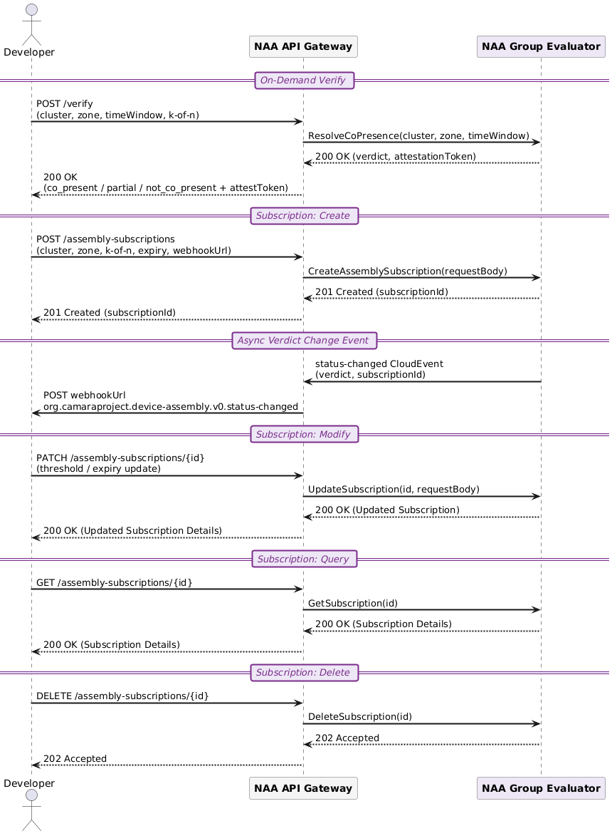
Sequence Diagram

Slide 8
User story
Item | Details
Summary | As an application developer or enterprise customer, I want to verify (using my application server/backend service) that a defined group of SIM-based devices are physically co-located within a specific zone and time window — so that I can automate trust decisions for security-sensitive physical workflows without exposing any device location to my application.
Roles, Actors and Scope | Roles: Enterprise Customer Actors: Application developers, enterprise security teams, industry customers (banking, logistics, field services, healthcare) Scope: On-demand co-presence verification (POST /verify) — Submit device cluster, get group verdict + attestation token Subscription-based continuous monitoring (POST /assembly-subscriptions) — Create / Query / Modify / Delete a monitored cluster subscription with webhook-based verdict change notifications
Activities / Steps | Starts when: The customer application server makes a POST /verify request (including device cluster identifiers, zone definition, time window tolerance, and k-of-n threshold) to the NAA API, triggering operator-side co-presence resolution across all specified SIM/eSIM devices. Returns: A group verdict (co_present / partial / not_co_present) and a signed privacy-preserving attestation token. No individual device location is returned to the callerFor subscriptions — Ends when: The customer application server makes a DELETE /assembly-subscriptions/{id} request, or the subscription expires automatically when subscriptionExpireTime is reached or subscriptionMaxEvents is exhausted.

Slide 9
API Deliverables status
Deliverable Required/Optional (R/O) Current status
API Specs | R | In Progress
API documentation | R | TBD
User stories | R | Available
Test cases | R | TBD
Implementation | O | TBD

Slide 10
Appendix

Slide 11
NAA Vs Device Locations
NAA is a New Abstraction Layer, Not a Device Location Enhancement
 | Device Location Verification | NAA
Input | 1 device + caller lat/lon | N devices, no coordinates
Output | Location boolean | Group relational verdict
Privacy | Caller knows the zone | Caller learns nothing about position
Caller supplies a zone definition . no resolved device coordinates are exposed to the caller
Output is a relational group verdict (co_present / partial / not_co_present), not a location value
Privacy-preserving by design: individual positions are never returned, even partially
Promoting it as a DeviceLocation enhancement would force callers to aggregate individual location results — increasing privacy surface and destroying the attestation model
The group verdict cannot be cleanly expressed as a DeviceLocation enhancement without breaking the core privacy guarantee — that is the architectural justification for a separate API family

Slide 12
Device Eligibility: Operator-Addressable Only
Cluster members restricted to SIM/eSIM identities — same schema as existing CAMARA APIs
Key Points:
Tags, beacons, gateways, and carts are removed from the proposal
All cluster members must use CAMARA-standard device identifiers:
phoneNumber (E.164)
networkAccessIdentifier
ipv4Address / ipv6Address
IoT trackers in scope only when SIM/eSIM-based (e.g. the armored vehicle tracker = cellular module with a phone number)
Non-operator-visible trackers (Bluetooth, Zigbee, LoRa) → explicitly out of scope, documented in spec
Every cluster member is independently verifiable by the operator using existing network-layer
No new operator capability required. This change directly resolves the interoperability concern.

Slide 13
Continuous Checks: Full CAMARA Subscription Model
"Continuous at scale" scoped as a proper subscription resource — aligned with Geofencing Subscriptions pattern
The subscription model is structurally identical to Geofencing Subscriptions — reviewers familiar with that API will find the pattern immediately recognizable
Subscriptions follow the CAMARA Event Subscription Template:
- Standard CRUD lifecycle
- CloudEvents payload
- Webhook delivery and retry rules
- Identical semantics to Geofencing Subscription

Slide 14
Questions posted on PR
Q1: Overlap — why not just enhance DeviceLocation? DeviceLocation evaluates one device at a time. NAA's atomic server-side group verdict (k-of-n across N devices) cannot be reproduced by calling DeviceLocation N times client-side — because the group verdict must be atomic, consistent across all devices at the same moment. Client-side aggregation breaks atomicity (race conditions, partial failures) and cannot produce a single signed attestation token. The delta is architectural, not just a feature flag.
Q2: Weak differentiation vs Location Verification? The normative gap: Location Verification returns a per-device boolean. NAA returns a relational group verdict with a k-of-n threshold enforced server-side. Standardizing this server-side is required for interoperability because:
the aggregation logic must be identical across operators
the attestation token must be verifiable by a relying party without re-querying individual devices, and
partial-presence states (partial) have no equivalent in Location Verification semantics.
Q3: Consent / privacy model underspecified? Two explicit modes:
Enterprise fleet : All devices are operator-registered assets under a single enterprise tenant. No end-user consent needed beyond enterprise subscription agreement.
Multi-user cluster: Each device owner must grant explicit OAuth scope consent. NAA returns only the group verdict — no individual coordinates, no identity linkage exposed via API. Data minimization: raw locations never leave the operator; only the boolean verdict + attestation token are surfaced.
Q4: Subscription model too vague? [To be discussed during Spec development] Subscription resource model (aligned with Geofencing Subscriptions pattern):
POST /assembly-subscriptions → creates subscription, returns subscriptionId
Event types: assembly.co_present, assembly.partial, assembly.not_co_present
Payload: CloudEvent envelope with subscriptionId, verdict, timestamp, attestationToken
Callback: HTTPS webhook; retries per CAMARA notification guidelines
Expiry/cancellation: maxDuration field + DELETE /assembly-subscriptions/{id}
Lifecycle states: ACTIVE → EXPIRED / DELETED

Slide 15
Additional Response to Questions
# | Point | Response
1 | Why a new API family, not just an enhancement to DeviceLocation? | DeviceLocation checks one device at a time. NAA answers a different question entirely: "Are these devices together?" — not "Where is this device?". The group verdict is produced atomically across all N devices at once. Calling DeviceLocation N times breaks that atomicity(indivisible/ granular most monolithic operation) and cannot produce a single signed attestation token. The distinction is architectural, not a feature flag. Promoting it as a DeviceLocation enhancement would also force callers to aggregate individual locations — increasing privacy exposure and destroying the attestation model
2 | What exactly can't be done with Location Verification? | Location Verification returns a per-device boolean. NAA returns a relational group verdict with a k-of-n threshold enforced server-side. Three things cannot be replicated client-side: (a) the aggregation logic must be identical across operators — standardization is required; (b) the attestation token must be verifiable by a downstream system without re-querying individual devices; (c) the partial state (some but not enough devices present) has no equivalent in Location Verification semantics
3 | How does consent and privacy work? | Two modes: (a) Enterprise fleet — all devices are operator-registered assets under a single enterprise tenant; no per-user consent needed beyond the enterprise subscription agreement. (b) Multi-user cluster — each device owner must grant explicit OAuth scope consent; NAA rejects the request if any consent is missing. In both cases, raw device locations never leave the operator — only the group verdict and attestation token are returned. No individual coordinates or identity linkage is ever exposed via the API.
4 | What does the subscription model look like? | The model is structurally identical to the Geofencing Subscriptions pattern. POST /assembly-subscriptions creates a subscription; events: assembly.co_present, assembly.partial, assembly.not_co_present; payload is a CloudEvent envelope with verdict, timestamp, and attestation token; delivery via HTTPS webhook with retries per CAMARA notification guidelines; expiry via maxDuration field; cancellation via DELETE /assembly-subscriptions/{id}. Detailed spec to be finalized during spec development.
Topic | Response
Zone input | Callers specify the zone as part of the POST /verify request. Cluster members are identified by standard CAMARA device identifiers (phoneNumber, networkAccessIdentifier, ipv4Address/ipv6Address) — no operator-specific zone ID required
Group verdict semantics | co_present — k-of-n minimum devices confirmed in zone within time window. partial — at least one but fewer than k confirmed. not_co_present — minimum not met. Unreachable or non-consenting devices count as absent; their errors are reported alongside the verdict. partial is a first-class outcome, not an error state.
Attestation token | A signed token returned with every verdict — acts as a tamper-proof receipt. Downstream workflows can act on trusted presence without re-querying the API or seeing any device location. No individual device positions or identities are included in the token.

Slide 16
Additional Response to Questions
Q1. LV comparison: DeviceLocation LV also has PARTIAL/UNKNOWN (and match rate). When you say NAA adds "partial" with no LV equivalent, what exactly is the normative gap: k-of-n at group level, "atomic" timing, the attestation token, or something else?
You're right that LV already returns PARTIAL and UNKNOWN for a single device. NAA's partial verdict means something fundamentally different — it is not about confidence in one device's position, it is about how many devices out of a group met the zone condition. So the core costruct is always different.
Example: a cluster has 4 phones, threshold is 3. If 3 are in the zone and 1 is not, NAA returns partial (3-of-4 present, threshold met) or not_co_present (if threshold required all 4). LV has no concept of "3 out of 4 devices" — it only scpopes about one device.
The normative gap is primarily k-of-n group evaluation: the operator evaluates the entire cluster server-side in one call and returns a single group-level verdict with a count. Secondary gaps are atomic timing (all devices evaluated within one bounded window, not N separate calls at different moments) and attestation token (a signed proof of the group result that downstream systems can trust without re-checking). None of these exist in LV — they are new semantics that cannot be replicated by calling LV per-device and aggregating client-side in a standardised, interoperable way.
Q2. Zone input: the deck says "no coordinates / no zone exposed", but you also say callers specify the zone in POST /verify (no operator zoneId). Should we assume the caller provides a Commonalities Area object (which implies area coordinates), or some other zone reference? If it's Area, are you ok to reword the deck to avoid confusion?
Yes, the caller provides a standard Commonalities Area object (circle or polygon with coordinates) in the request body. The deck phrase "no coordinates exposed" was meant to describe the response side — NAA never reveals any device's resolved location back to the caller. We acknowledge this wording caused confusion and will reword the deck to: "Zone is supplied by the caller as a standard Area object; no device coordinates are exposed in the response."
Q3. "Atomic" verdict: what is the intended normative definition (single evaluation timestamp vs time window with maxAge/timeTolerance per device)? How should unreachable/transient failures be treated (absent vs unknown) and reported?
"Atomic" means: all devices in the cluster are evaluated within a single bounded time window, defined by the caller's maxAge parameter. It is a time window, not a single-instant timestamp. Each device's last-known position must fall within maxAge of the evaluation moment.
Failure handling:
Unreachable (device off, no coverage): reported per-device as UNREACHABLE, counts as not present toward k-of-n.
Transient error (temporary network issue): reported per-device as UNKNOWN, also counts as not present.
If unreachable + unknown devices push the present count below k, verdict becomes partial or not_co_present.

Slide 17
Additional Response to Questions
Q4. Multi-user consent: how do you plan to collect/verify consent for multiple device owners in an interoperable way (given typical OAuth tokens are single-subject)? Would you consider scoping v0.x to enterprise fleet first and add multi-user later?
Consent model (aligned with CAMARA guidance):
Enterprise / Fleet mode (v0.x):
- All devices belong to a single enterprise tenant
- No end-user personal data is exposed via the API
- Client Credentials (2-legged OAuth) permitted
Multi-user mode (future):
- Devices belong to different end users
- Explicit user consent required per device
- Authorization Code (3-legged OAuth) required
- Out of scope for v0.x
The approach is 2‑legged tokens must only be used when no personal data is processed. However, the whole approach we will review in WG calls
Q5. Subscriptions: do you expect the subscription resource (endpoints, lifecycle, payload, retries, expiry/cancel, errors) to follow the CAMARA event subscription template one-to-one, or any deviations?
One-to-one alignment with the CAMARA event subscription template.
No custom lifecycle, payload, or retry semantics.
Deviations (e.g., PATCH) are optional and may be dropped per WG guidance.

Slide 18
Truth Table & Additional inputs
`co_present` = All present (m = N)
`partial` = Threshold met, not all (k ≤ m < N)
`not_co_present` = Below threshold (m < k)
So in the example (N=4, k=3, m=3): verdict is `partial`. However, this is the concept. We can review this and update as necessary while developing the Swagger spec.
Response fields: Yes, the response will include
Response fields:
- totalCount (N)
- requiredCount (k)
- presentCount (m)
- thresholdMet (boolean)
thresholdMet = true if m ≥ k
thresholdMet = false if m < k
The `partial` verdict MUST NOT be interpreted as uncertainty.
It explicitly means the required threshold was met (thresholdMet = true),
but not all devices were present.

